Slide 1
EnergySave
Prediction and Analysis of Household Energy Consumption
Problem Statement 3

Slide 2
Current Trends
All Appliances which don’t come under Energy Star Rating Program
Consumers don’t know Appliance energy consumption issues without Servicing

Slide 3
Use-cases
Predict the Energy Star Rating of old or vampire appliances without a energy star rating
Predict reasons for high energy consumption using the valuable insights provided

Slide 4
Impact and Outreach
General consumers can predict star rating
Increase awareness for Energy Star Products
Insights generated useful to consumers and product service organizations
Consumer data and inferences shared to Energy Saving Efforts and Organizations

Slide 5


Our Team
Aditya Vinod Kumar
Rishi Ravikumar
Project Lead, Worked on Data Analysis, Prediction Models, Design flow and Backend
Worked on UI and Design Flow for Front End

Slide 6
Flow
User Data on Appliance Specifications
Data on Appliances and their Health
Tune Model for Prediction
Predict Star Rating for Appliance
Insight into Energy Wastage
Add data for better analysis

Slide 7
Tools and Technologies Used
The project can be found on Github - Link
Datasets - Dataset Link
Model Prediction - Scikit linear classifier models using Jupyter Notebook
Backend - Python’s Flask server
Frontend - React Framework
Refer README.md for more information on the Setup and Open Source Contribution for this project

Slide 8
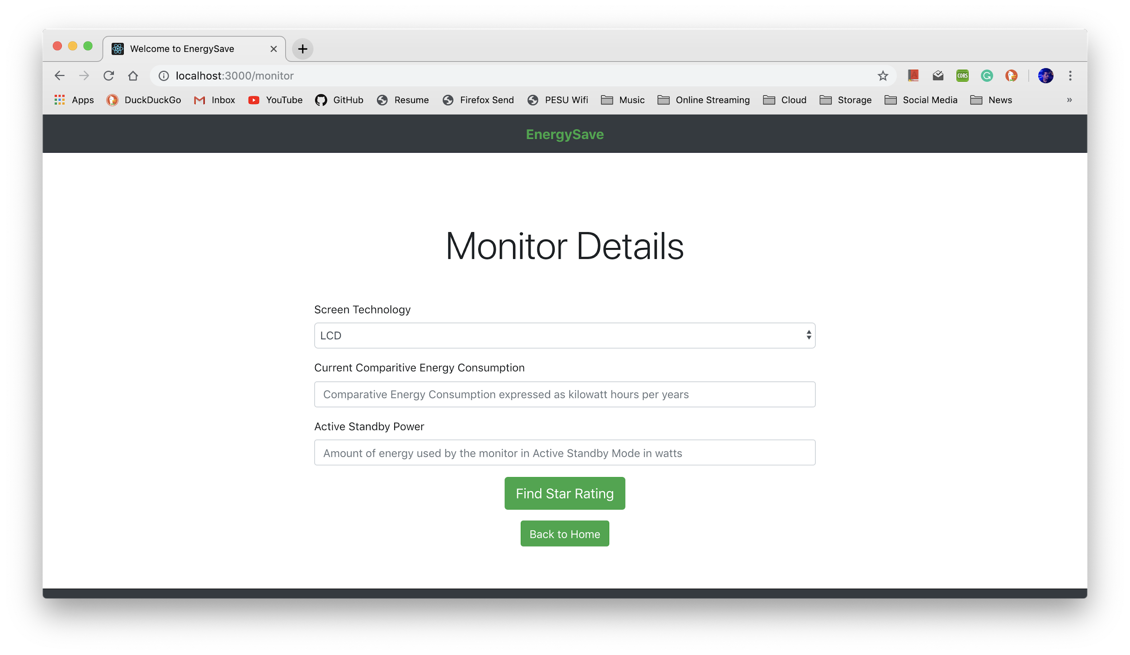
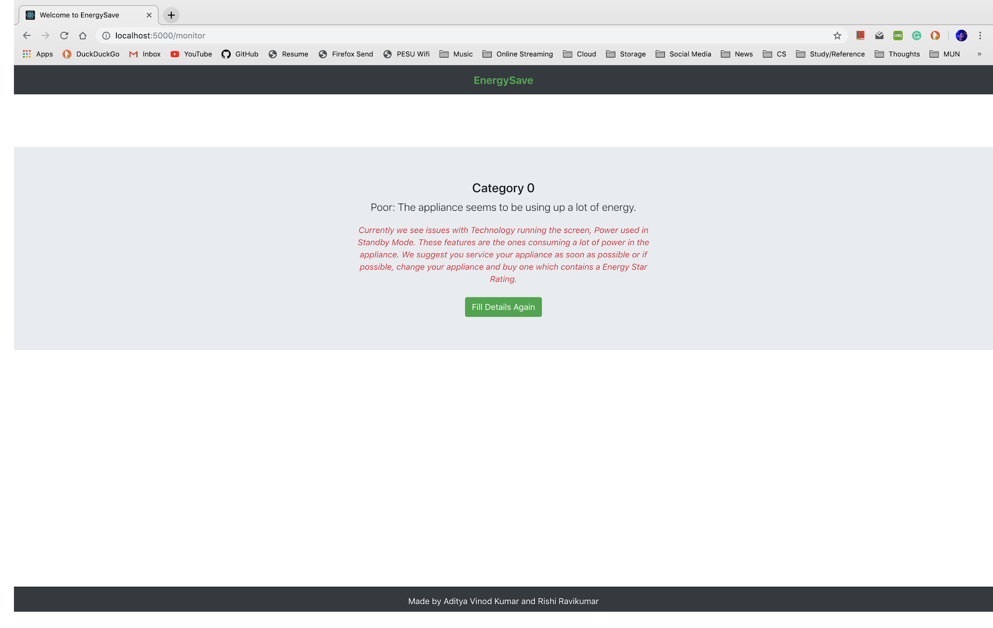
Images

Slide 9
Scaling Project
Currently the project does not have a Business Model and is intended to be used as a free service. However some of the plans of scaling the project include -
Flexibility on Input Data
Convert to real-time data usage
Provide information to product service centres or energy star organizations

Slide 10
Thank You
Kindly contribute to our project on Github!

